Slide 2

Research School of Astronomy & Astrophysics
ASTR8010 Keynote:
Negative Metallicity Gradients in Galactic Outflows Based on QED Simulations
Rongjun Huang (Rongjun.Huang@anu.edu.au)
Supervisors: Aditi Vijayan & Mark Krumholz
Date: [12/06/2024]

Slide 3
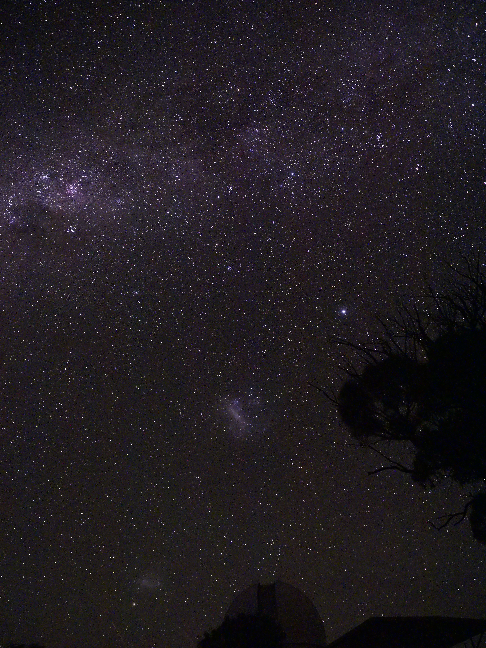
Table of Contents
• Introduction
• Data & Methods
• Results
• Discussion
• Conclusions

Slide 4
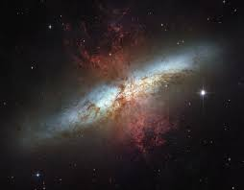
Introduction
Background and Motivation
- Metals are found far from the galactic disk, suggesting transportation mechanisms like outflows.
- Galactic outflows play a critical role in metal transport in galaxies
- Numerous simulations have investigated the metal loading of galactic outflows, but require the use of high-resolution simulations to study the complex multi-phase nature of these outflows.
M82 Credit: ESA
Notes:
The background starts with an observational phenomenon: Even though all of the metals are created in the disc, ~50% of the mass of metals like oxygen is found in galactic halos and this raise an interesting question: How are these metals transported from the central disk to the halo? One plausible explanation is that metals are carried by supernova (SN)-driven galactic outflows, which can transport material, momentum, and energy from the disk to the halo. Observational studies have shown that galactic outflows tend to be metal-rich, with metallicities higher than the interstellar medium (ISM). However, the physical processes driving metal transport in these outflows are still not well understood. On the other hand, numerous simulations have investigated the metal loading of galactic outflows, but they face significant uncertainties due to the complex interplay between the limited resolution of the simulations and different gas phases, e.g., a wide range of temperatures and densities. That means we need a high-resolution simulation that can resolve the interactions involving mass, momentum, and energy exchange among multi-phase gases.

Slide 5
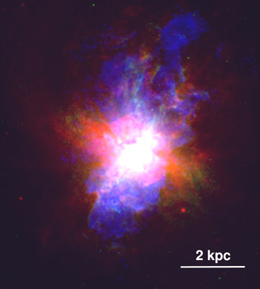
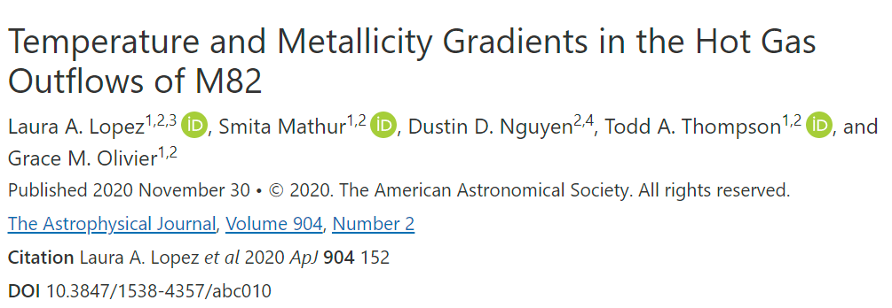
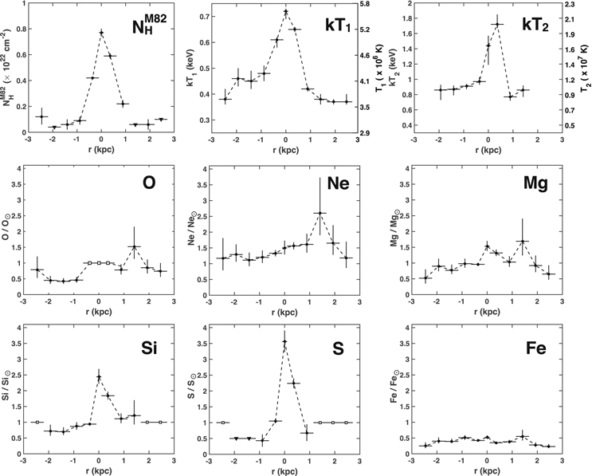
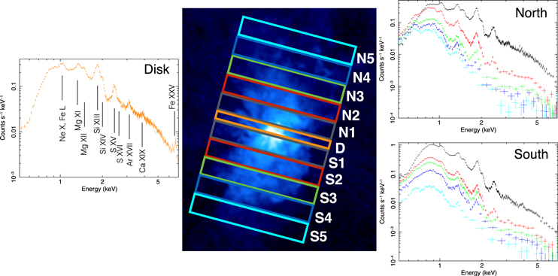
Introduction
What is the “Negative Metallicity Gradient in Galactic Outflows”?
Hypothesis:
negative gradient is created due to incomplete mixing of metals
Notes:
And what is the “Negative Metallicity Gradient in Galactic Outflows”? Here is a recent study of Lopez 2020. They use the Chandra X-ray Observatory imaging and spectra to look at the hot gas outflows of the M82. As you can see on the RHS, it is a typical edge-on starburst galaxy and on the LHS are their main results. They found that temperatures and metallicities of the hot plasma peak at the starbursting mid-plane and decrease along the outflowing regions, which is the so-called negative gradient in galactic outflows. Our hypothesis is that such a negative gradient is created due to incomplete mixing of metals.

Slide 6
Introduction
This Study
- Use high-resolution three-dimensional hydrodynamic simulations of outflows to generate synthetic X-ray spectra
- identify observational signatures of the physical processes found in the simulations
Research Objectives
- To validate that the simulations yield observationally plausible results.
- Use the simulations to provide predictive insights for actual astronomical observations.
M82 Credit: ESA
Notes:
So this observation of M82 motivates our study. To better understand this negative metallicity gradient we use high-resolution three-dimensional hydrodynamic simulations of galactic outflows to generate synthetic X-ray spectra and identify observational signatures of the physical processes found in the simulations. The primary focus of our work is to bridge the gap between complex numerical simulations of SN-driven galactic outflows and their observational signatures. We aim to validate that the simulations yield observationally plausible results and use the simulations to provide predictive insights for actual astronomical observations. So the first step in our study is to use the simulation to recreate the negative metallicity gradient in galactic outflows.

Slide 7
Data & Methods - The QED simulations
Simulation data (QED data) | For more details -> (Vijayan et al, 2024)
- generated by a new radiative hydrodynamic code called QUOKKA (Wibking & Krumholz 2022), a state-of-the-art GPU-based adaptive mesh refinement (AMR) radiation-hydrodynamics (RHD) tool
Data properties:
- fixed-grid simulations: ∼ 1 × 1 × 8 kpc3
- a uniformly high resolution of 2 pc
- parameters chosen to be similar to the Solar Neighbourhood
- gas is confined by a potential representing gravity from the stellar disc and the dark matter halo
- SNe occurs at a rate set using the Kennicutt (1998) relation
- gas cooling is implemented through the Grackle cooling model (Smith et al. 2017)
Notes:
But before we start, I need to introduce our simulation data. We use the simulation data, also known as QED data, generated by a new radiative hydrodynamic code called QUOKKA. So here are some key properties of the QED data. It is the fixed-grid simulation of a ∼ 1 × 1 × 8 kpc patch of a galactic disc, centred on the x-y plane, and using a uniformly high resolution of 2 pc. All the parameters are chosen to be similar to the Solar Neighbourhood. Gas is confined by potential gravity from the stellar disc and the dark matter halo. SNe occurs at a rate set using the Kennicutt (1998) relation. Gas cooling is implemented through the Grackle cooling model (Smith et al. 2017).

Slide 8
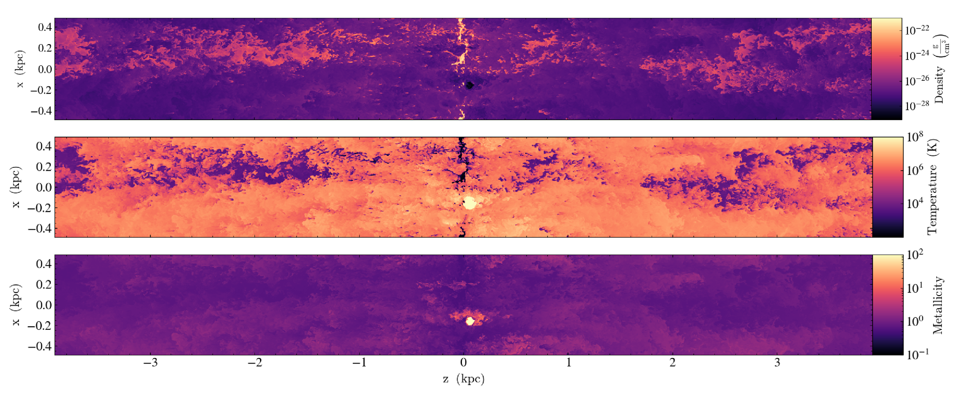
Data & Methods - The QED simulations
- part of a series utilizing the QUOKKA-based Understanding of Outflows Derived from Extensive, Repeated, Accurate, Thorough, Demanding, Expensive, Memory-consuming, Ongoing Numerical Simulations of Transport, Removal, Accretion, Nucleosynthesis, Deposition, and Uplifting of Metals suite, also known as QED (Vijayan et al. 2024).
Notes:
And you may be curious about why we call it QED data. So it is actually …
For full details of the simulation setup, please look at Aditi’s paper in 2024.
After nearly 100 Myr, the simulation produces a quasi-steady-state outflow. Here we show the visualization of our simulation data. These are slice plots in the 𝑥-𝑧 plane from a snapshot of the QED data at 110 Myr of evolution. From the top to bottom we show gas density, temperature and metallicity per unit volume in the 0.3 − 2 keV band. The outflows clearly possess a multiphase structure characterized by a broad range of temperatures from < 10 K to > 10^7 K, with higher temperature gas being associated with lower densities. And the X-ray emitting gas is the hot gas with temperature higher than 10^7 K.

Slide 9





Data & Methods - Metallicity
Assumption: solar-scaled abundances for elements other than oxygen
The simulations treat metals as a passive scalar
SN adds the passive scalar to its host cell along with purely thermal energy
Background metallicity , varies from 0.2 to 2.0 solar in our analysis
Background metal density in each cell
When an SN occurs in the domain, the passive scalar density in the host cell is increased by
Metal density contributed to each cell by the passive scalar
The total metal density of a cell is the sum of the background and SN-added contributions:
Notes:
Now, we need to look at the metallicity.
The simulations treat metals as a passive scalar, so when an SN explodes, it adds the passive scalar to its host cell along with purely thermal energy. The initial metal density within the simulation is set to a background level specified by the parameter Z_bg, so we have the background metal density in each cell:
When an SN occurs in the domain, the metal density contributed to each cell by the passive scalar is the following \rho_{Z, add}:
Finally, the total metal density of a cell is the sum of the background and SN-added contributions, and so the Z_tot is given by the equation
And we make an assumption here. Once the oxygen metallicity is computed in each cell, we assume solar-scaled abundances for all other elements. This is not entirely realistic, as the simulation models only type II supernovae, which produce predominantly alpha elements, rather than type Ia supernovae, which produce iron-peak elements. However, we will limit our analysis to alpha elements, so the effects of this simplification will be minimal.

Slide 10
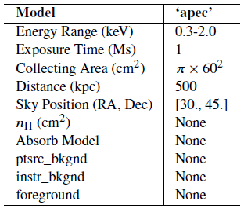
Data & Methods - Generation of synthetic X-ray data
Tools: yt (Turk et al. 2011), pyXSIM & SOXS (ZuHone & Hallman 2016; ZuHone et al. 2023)
Initial setup parameters in pyXSIM:
+---------------------+
| Load Snapshot |
| - yt analysis |
| - Cube of data |
+---------------------+
||
v
+------------------------------------------+
| Choose Background Metallicity |
| - Z_bg variations |
+------------------------------------------+
||
v
+-------------------------------------------+
| Generate Photon Samples |
| - pyXSIM |
| - collisionally ionized equilibrium
(CIE) & optically thin |
| - APEC (Smith et al. 2001) |
+-------------------------------------------+
||
v
+------------------------------------+
| Set Photon Energy Range |
| - 0.3-2.0 keV |
| Set Simulation Parameters |
| - Collecting area |
| - Distance, Exposure |
| - Disable absorptions |
| (see the table in the LHS) |
+-----------------------------------+
|
v
………………………………
Notes:
Ok now with the simulation data in hand, we can start to generate the X-ray field. Here we use the X-ray post-processing packages pyXSIM and SOXS to generate the synthetic observations. The first step is to load a QED simulation snapshot into the yt. So yt is a package for analyzing the simulation data. So now the snapshot will be a data cube with the simulation volume and properties like density, temperature and everything. Next, we apply the equation we mentioned before to calculate the metallicity, with different choice of Z_bg in 0.2, 0.5, 1 and 2 solar. We then pass this yt object to pyXSIM and use pyXSIM to generate a sample of photons emitted by each cell of the simulation domain, under the assumption of CIE and optically thin condition. And pyXSIM computes X-ray emissivities derived from APEC, which is the Astrophysical Plasma Emission Code. Because we are interested in the soft X-ray band, which is generally used for observations of metals in galactic winds, we limit the photon energies to the range 0.3−2.0 keV. In order to ensure that we generate enough photons to produce high signal-to-noise spectra, we set up a large enough collecting area, the distance of the source to be 500 kpc, and the exposure time to 1 Ms. We also disable absorption, backgrounds, and foregrounds, so that we can have a prue unattenuated spectrum from the source.

Slide 11
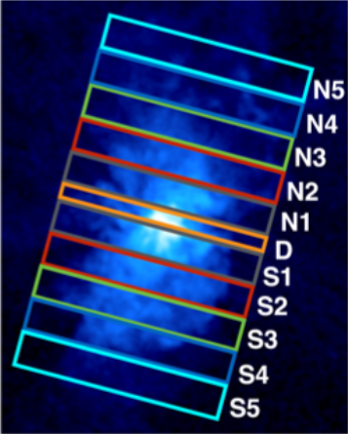
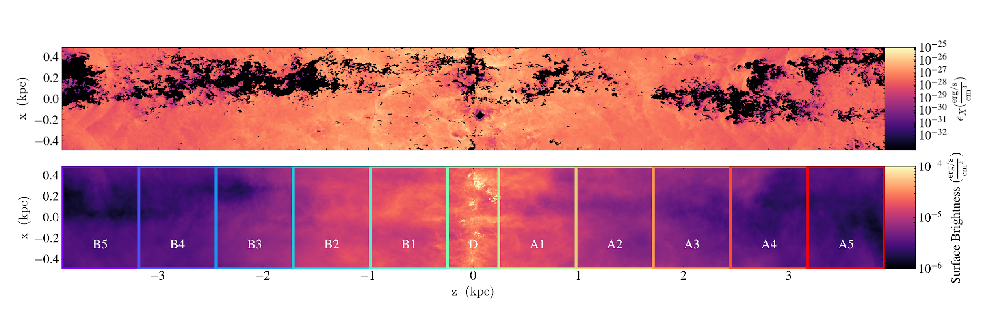
Data & Methods - Generation of synthetic X-ray data
+---------------------------------------------+
| Stack Emissions from Snapshots |
| - 5 snapshots (100-120 Myr) |
+---------------------------------------------+
|____________________>
+-------------------------------------------------------+
| Generate Mock Observations with SOXS |
| - Edge-on view |
| - ACIS-I response |
| - Partition galaxy (11 regions) |
+-------------------------------------------------------+
(Lopez, 2020)
Notes:
Before we use the SOXS to generate the synthetic images and spectra, one thing we need to do is snapshot stacking. Recall that our simulation covers only a 1 kpc×1 kpc patch of a galactic disc, which is much smaller than a real spiral galaxy. To compensate for this, we can imagine that different time snapshots represent different random realisations of patches of the disc. We therefore stack emission from five snapshots uniformly distributed in time from 100 to 120 Myr. We use a 5 Myr interval to make sure that each snapshot is not linked to each other, because 5 Myr is long enough that any hot gas can travel from the mid-plane to the top or bottom edge of the simulation domain. And now we can use the SOXS to do the mock observation. First, we make sure the galaxy is edge-on. Then we use the response function for the ACIS-Image on board the Chandra. We follow the approach of Lopez et al. (2020) for M82 and slice our galaxy into 11 regions that are analysed separately. The central region of the galaxy, denoted as ‘D’, and it is the place where SNe are injected. The remaining 10 regions will cover the outflow regions. So the figure here shows X-ray fields for our simulated galaxy. The upper panel shows a slice plot of the X-ray emissivity field in the x-z plane from a single snapshot at 110 Myr. The lower panel displays X-ray surface brightness after stacking the X-ray emissivities from five different snapshots. And the rectangles in different colors highlight the 11 regions used for spectral analysis.

Slide 12
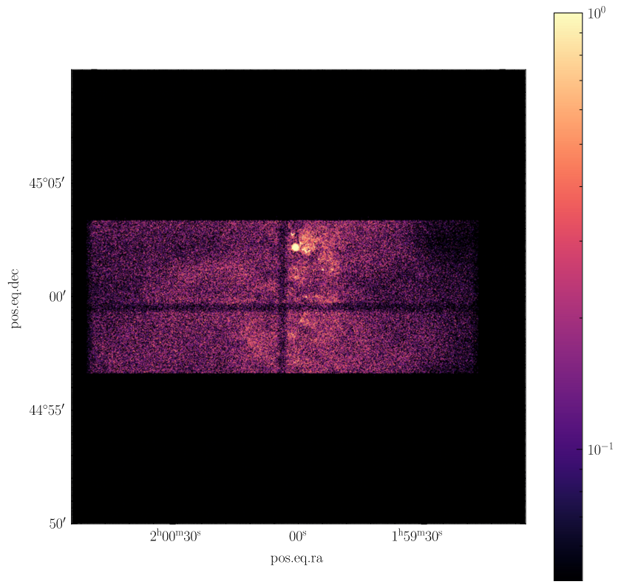
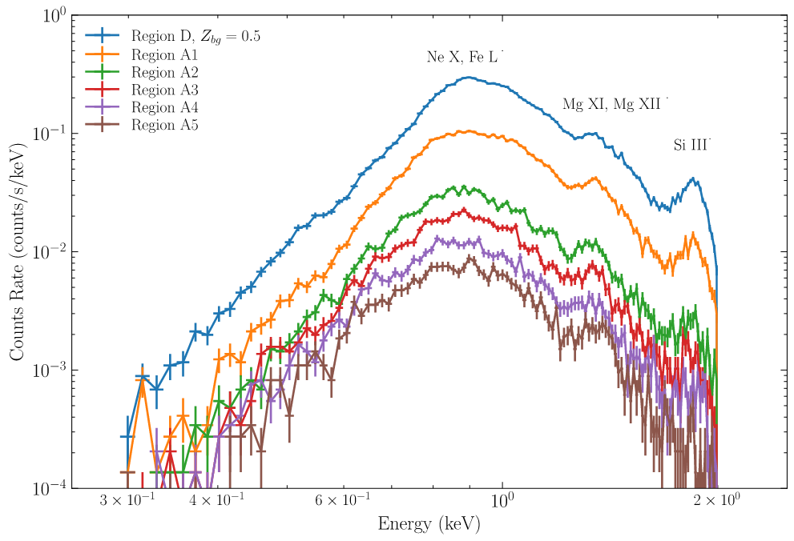
Data & Methods - Generation of synthetic X-ray data
+---------------------------------+
| Set SOXS Parameters |
| - Exposure time=1Ms |
| - Distance=0.5 Mpc |
| - Effective area
=0.04 m^2 |
+---------------------------------+
|
v
+---------------------------------+
| Integrate Photon Counts
and Extract Spectrum |
| - Over spatial extent |
| - Generate PHA
format spectrum |
+---------------------------------+
Notes:
For the spectrum generation, we also need to set up additional parameters for SOXS. The exposure time is still set to 1 Ms and Distance to the observed object will still be 0.5 Mpc. The effective area is set to 0.04 square meter, which is exactly the same as the effective area of Chandra.
The figure here shows what the galaxy looks like in Chandra's observation in the 0.3 - 2 keV band with the colorbar representing photon counts per pixel.
And remember that we have sliced the simulation volume into 11 regions, we integrate the photon counts over the spatial extent of each region and generate the spectrum in the standard PHA format. That is the common format used for X-ray spectral analysis. So the figure on the RHS shows the spectra for the central disc and the A1-A5 regions above the mid-plane.

Slide 13
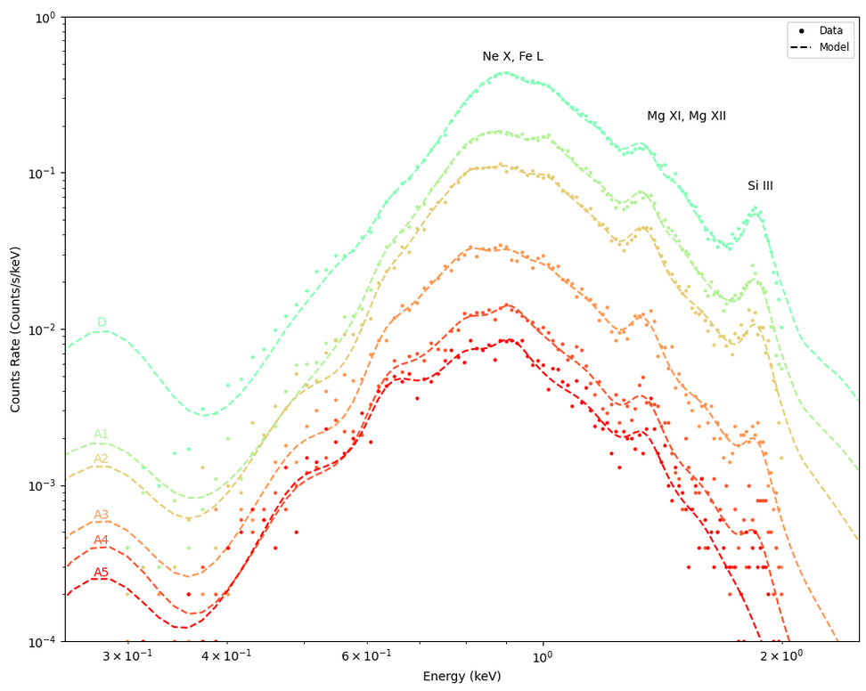
Data & Methods - Fitting the X-ray Spectrum
Tools: SHERPA, a fitting tool of CIAO (Chandra Interactive Analysis of Observations)
Fitting model: xsvapec.plasma1 + xsvapec.plasma2
Abundances:
O, Ne, Mg, Si,
S, and Fe
+------------------------------------------------+
| Setup Fitting Tool |
| - optically thin thermal plasma component in collisional ionization equilibrium (CIE) |
| - One/two temperature based on reduced χ²: 2 plasma components for regions near the disc (A/B1,2, and D) |
+------------------------------------------------+
|
v
+---------------------------------+
| Elemental Abundances |
| - Variable parameters |
| - Initial guesses: solar |
+---------------------------------+
Notes:
So, the next step is fitting the spectra. Here we use Sherpa, which is a fitting tool of CIAO. So by our assumption, we can fit the spectra with a single, optically thin thermal plasma component in CIE with variable abundances. However, we found that within the inner regions (approximately ±2 kpc from the galactic mid-plane, that is the regions B2-A2), introducing a second plasma component significantly improves the fitting results based on the reduced chi-square statistics. Metal abundances, which are Oxygen (O), and Neon (Ne), are considered variable parameters within the spectral models, with their initial guesses starting at solar values. So on the RHS, the data points are the synthetic spectra and dashed curves are the fitting models for different regions.

Slide 14

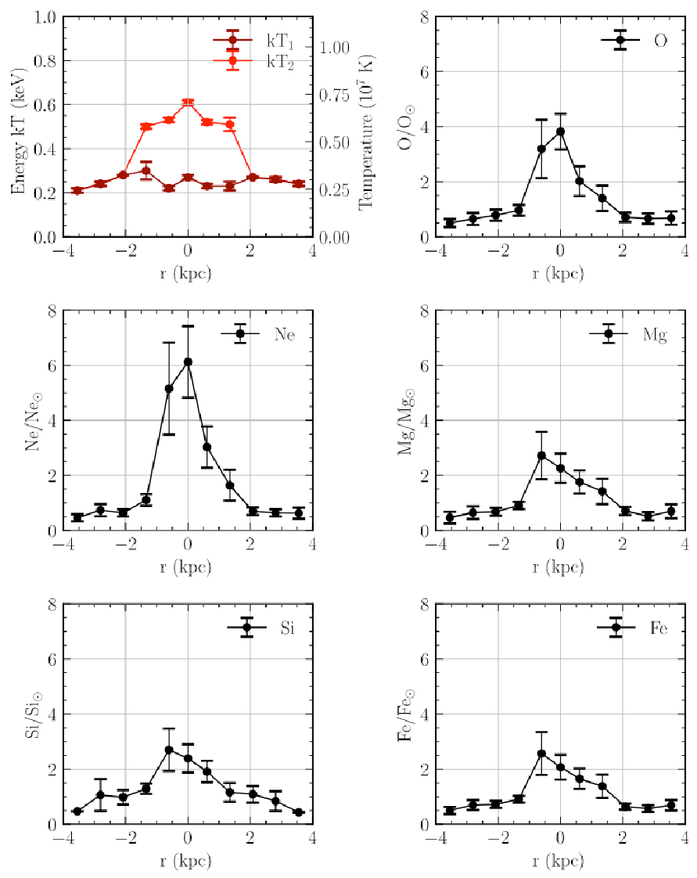
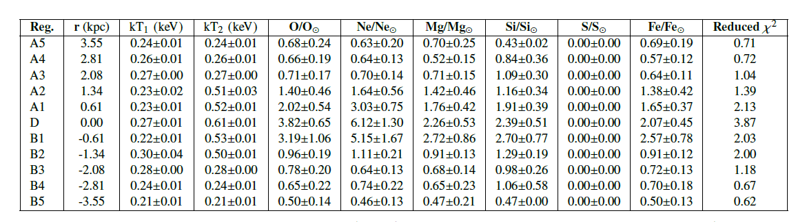
Results - Metallicity Gradients in Galactic Outflows
Notes:
Finally, we present the main result here. We first focus on the case 𝑍_bg = half solar as a baseline for the following discussion and comparisons. Obviously, the metallicity gradients are recreated. The metallicity is higher in the central disc and falls off at higher altitudes. We can see pronounced metallicity gradients for oxygen and neon abundances with the peak in the central disc region. For other elements, the peaks are shifted slightly. It is not a systematic trend. This effect may be due to the stochastic nature of the simulations, e.g., the result of some SN events. And you may also notice that we do not include Sulfer in the Figure and its fitting results in the Table on the RHS are Zero everywhere. This is because Sulfer emission lines are predominantly outside the 0.3-2.0 keV range.

Slide 15
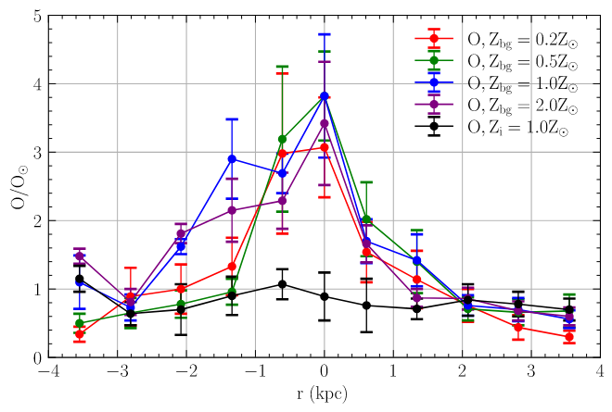
Results - Impact of the Background Metallicity
Notes:
As I mentioned before, we will look at the other cases with different background metallicities. So we repeat the procedures for different Z_bg (that is 0.2, 1.0, 2.0 solar) and here we show the variation in Oxygen abundance across different background metallicities. The peak of the metallicity still lies in the central disk region where fresh SNe are going off. Beyond the disk, all gradients decline. Normally, we are supposed to see the gradient should be flattened in high-background metallicity cases because higher Z_bg can reduce the effects from SNe. However, in our study, the gradients appear to be independent of 𝑍_bg. And so we will discuss this phenomenon later.

Slide 16
Discussion - Origin of Metallicity Gradients
Imperfect mixing between the metal-rich hot gas from supernova (SN) events and the surrounding interstellar medium (ISM).
Notes:
Now let’s look at the origin of metallicity gradients in galactic outflows. Our interpretation is that it is primarily due to the imperfect mixing between the metal-rich hot gas from supernova (SN) events and the surrounding interstellar medium (ISM). When a supernova explodes, it releases a significant amount of metals into the surrounding area, resulting in extremely high metallicity near the galactic disc. However, the metal-rich hot gas does not immediately mix with the colder, metal-poor ambient gas. The mixing efficiency and the time scale are influenced by several factors, such as gas density, turbulence, and magnetic fields. This gradual mixing process dilutes the metal-rich gas, leading to a decrease in metallicity as the outflows move far away from the galactic plane. Consequently, this is the observed metallicity gradients, with higher metallicities near the mid-plane and lower metallicities along the galactic outflows.s

Slide 17

Discussion - Reliability of Metallicity Gradients
Notes:
To test the reliability of the metallicity gradients observed in the synthetic X-ray data, we performed a sanity check by setting the metallicity of the gas as a uniform metallicity of 1 solar everywhere throughout the simulation.
That is the black line in this figure. So as you can see, there is nearly no gradient in this uniform metallicity case. That means the observed gradients are in fact a result of the metal loading in different Z_bg. But, we also notice that even in this uniform-metallicity case, the derived metallicity is not exactly solar, suggesting that statistical variation may enhance gradients in actual observations.
However, we still don't know why we see a gradient here in the high background metallicity case. So the next step will be to figure out the reason here, especially for the Z_bg = 2 solar.

Slide 18

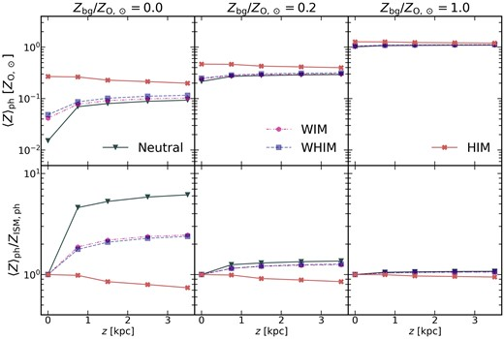
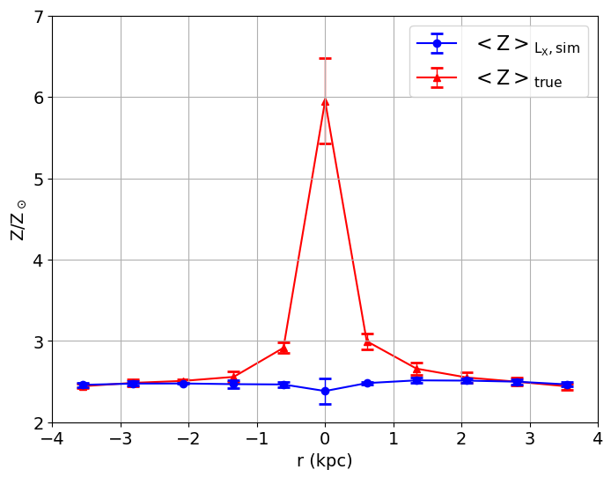
Discussion - Reliability of Metallicity Gradients
(Vijayan et al, 2024)
Notes:
So in Aditi’s paper, they show a nearly flat profile of the mass-weighted mean metallicity. So our idea is to test if our metallicity estimate was biased by weighting the X-ray luminosity.
And so we calculate the X-ray luminosity-weighted metallicities of those 11 regions, and the data indicates an overall very flattened line in the X-ray luminosity-weighted metallicity, which is the bottom blue line on the RHS. So the high-metallicity hot gas does not dominate the X-ray emission, and that means the metallicity estimate was not biased by weighting with the X-ray luminosity. And the red line here is the so-called true value of volume-weighted mean metallicity directly calculated by the simulation. As you can see, in the inner region, the strong emission lines from high-metallicity gas can lead to high metallicity measurements in the fitting results. So the question now is to understand the origin of these strong emission lines.

Slide 19
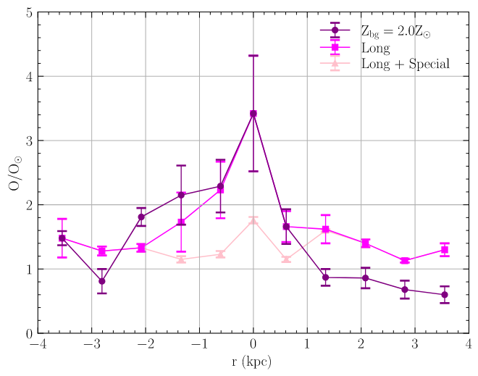
Discussion - Reliability of Metallicity Gradients
Two contributing factors:
1. underestimated values in the outer regions
2. the peak in the inner region
Two hypotheies tests:
1. ‘Long’ treatment: exp_time -> 10Ms
2. ‘Special’ treatment: ‘Long’ + Zero emission from Extreme Metallicity Cells
Therefore,
1. poor SNR leads to underestimation of metallicity values
2. ultra-high metallicity cells bias the results
Notes:
Now we go back to this figure. When we visually inspect the observed gradient for Z_bg = 2 solar, there are actually two contributing factors: underestimated values in the outer regions and the peak in the inner region.
--
--
So let’s look at the outer regions first. Clearly, the underestimation can be due to the noisy spectra at the edges of the outflows compared to the mid-plane. And a very straightforward method to address this issue is just simply increasing the exp_time.
--
--
Previously we used 1 Ms, and now we use 10 Ms. In the figure, compared to the original purple line, the magenta line has higher metallicity values in the outer regions. It is still only 1.5 rather than 2 solar, but we consider it may be due to some systematic underestimation. And then for the inner region, we think the peak can be due to the some Extreme Metallicity Cells. And so we further turn off the X-ray emission for any cell with metallicity higher than 10 solar. So you can see that the pink line in the figure has nearly no gradient now.
Therefore, we know that poor SNR leads to underestimation of metallicity values and ultra-high metallicity cells biase the results. Of course, in reality, we can increase the exp_time to improve the SNR of the spectra, but there is no way to ask the galaxy to turn off the emission from the ultra-high metallicity hot gas.

Slide 20
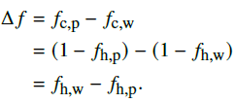

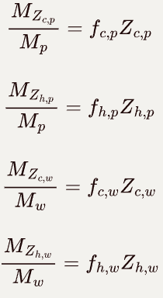






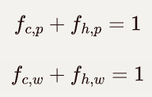


Discussion - From Simulation to Observation
Metal transport (4-grid model) | Cold (< 1e4 K) | Hot (> 1e7 K)
Wind
Plane
Notes:
In this section, we want to link the simulations and observational data. Here, we develop a simple 4-grid model. We just simply assume that there 4 components, cold gas and hot gas in the Galactic wind and the midplane. So the hot gas is loaded with metals and the dilution from the cool gas brings down the metallicity. But we need to highlight that this is a cartoon model and the actual temperature distribution is much more complex. We just simplify the process here.
And I just skip the set up here.
--
--
--
--
--
And now i put these 4 expressions into our 4-grid model. And then we need to define a parameter called Delta f.
The Delta f here represent the fraction of cold gas in the mid-plane evaporated to be the hot wind component.
And so with the Delta f, we can rewrite the metal mass in hot wind in this expression.
Notice that these two parts are equivalent, so we have the following equation.

Slide 21
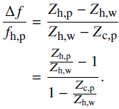
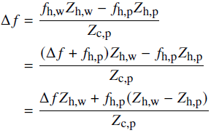

Discussion - From Simulation to Observation
Notes:
With these two equations, now it is purely algebra.
---
---
We can now the final expression of Delta f. As you can see, now the RHS are all the metallicity ratios, which can be easily measured from observations.

Slide 22



Discussion - From Simulation to Observation
In the scenario of a low metallicity background, we can assume:
Recall that:
Notes:
But we can still take one step forward.
In the scenario of a low background metallicity, it is reasonable to assume 𝑍_c,p ≪ 𝑍_h,w or 𝑍_h,p.
And so we have these two approximations.
Finally, by the definition of Delta f,
we have the simplified expression in the case of low background metallicity. So the relation here clearly demonstrates that for any metallicity ratio measure at any given area of galactic outflows, we can immediately estimate the amount of cold gas required to mix with the hot gas from mid-plane to observe the such metallicity ratio. For example, if observations of a galaxy show that the metallicity of the hot wind is half that of the hot mid-plane gas, the simplified relation implies that there are roughly 2 times the mass amount of cold gas in the galactic outflows is consumed to dilute the hot gas from the mid-plane.

Slide 23
Conclusion
Summary
* Synthetic Observations
synthetic X-ray spectra generated from high-resolution hydrodynamic simulations (QUOKKA)
* Negative Metallicity Gradients
significant metallicity gradients within galactic outflows, with higher metallicities observed near the central disc and decreasing with distance from the mid-plane
* Imperfect Mixing
the observed gradients result from imperfect mixing between hot gas from supernova ejection and the surrounding interstellar medium (ISM)
* A toy model
a simplified model linking the metallicity ratio in observations to the mixing process between hot and cold gases

Slide 24
Conclusion
Limitations
* Simplified Metallicity Assumptions
simulations assume solar-scaled abundances for all elements
* Metallicity in simulation
Simulations treat metals as passive scale, cooling not self-consistent
Future Work
* Quantify the effect of Signal-to-Noise Ratio (SNR)
* Produce mock observations for future X-ray telescopes
* Extended Observation Bandwidth
* Publication in prep. (coming s∞n)
Notes:
Skip limitation

Slide 28
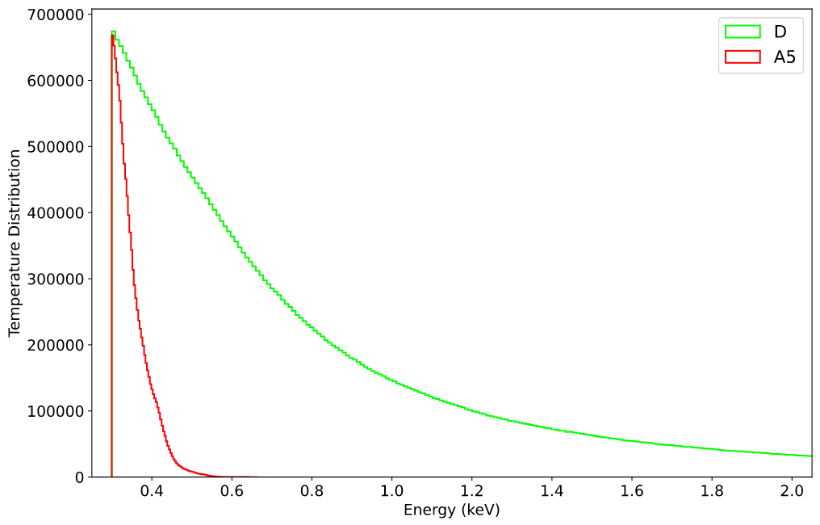

Slide 29
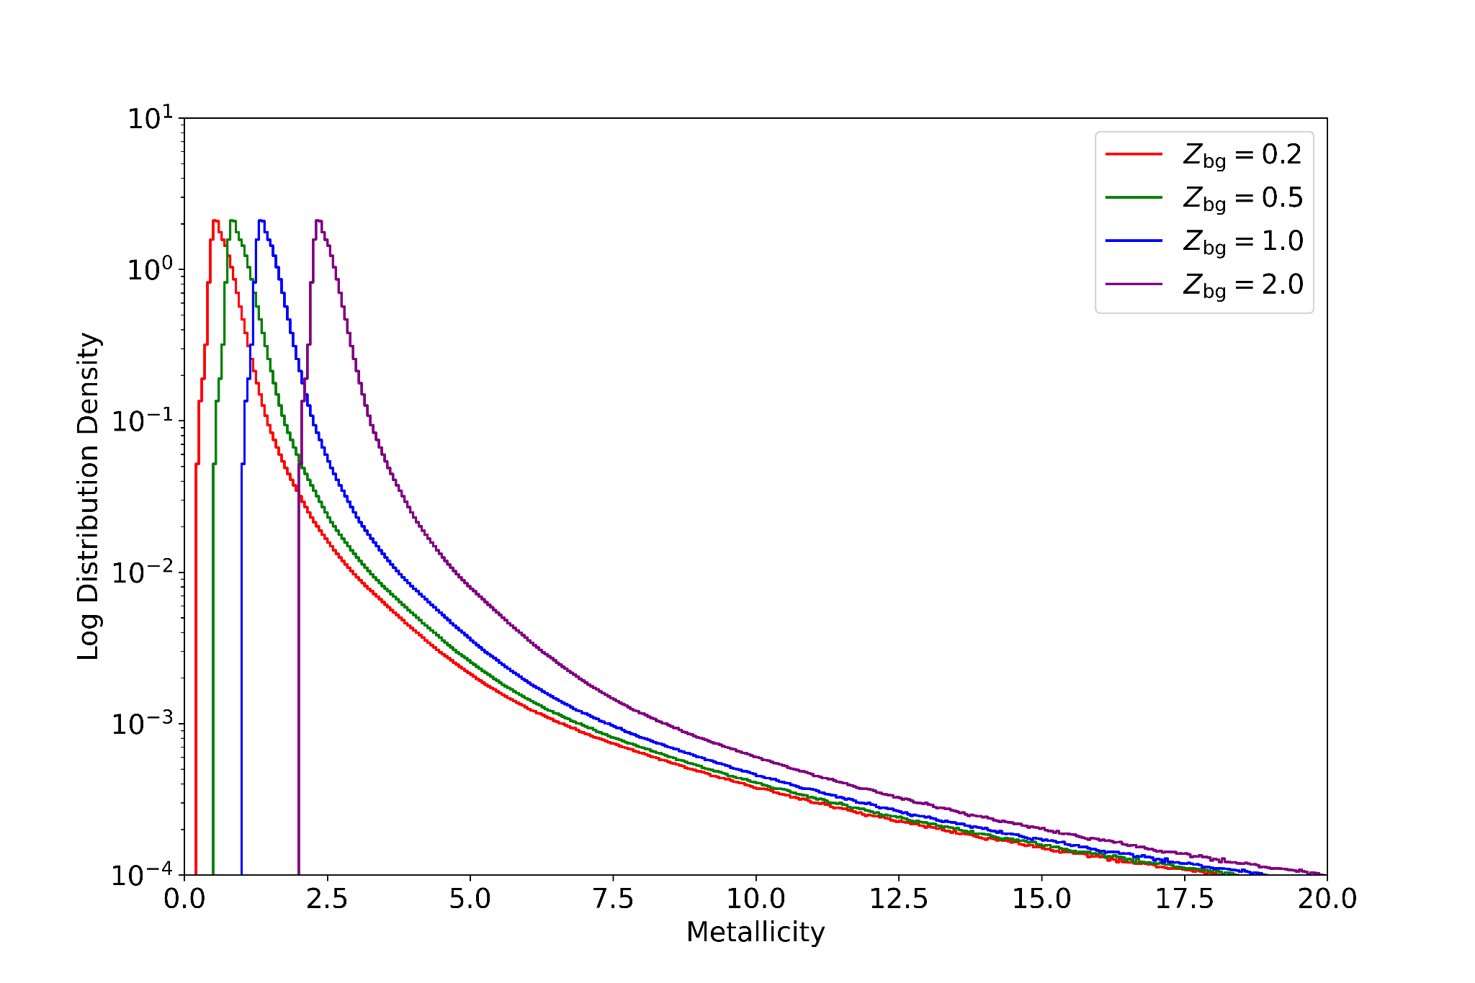

Slide 30
